Slide 1
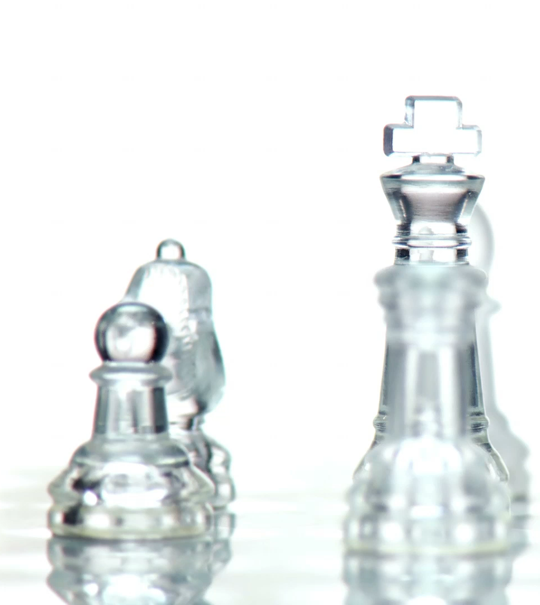
Blackjack Game (HTML & CSS)
Mahendra Krishna Koneru
Joshika Alaparthi

Slide 2
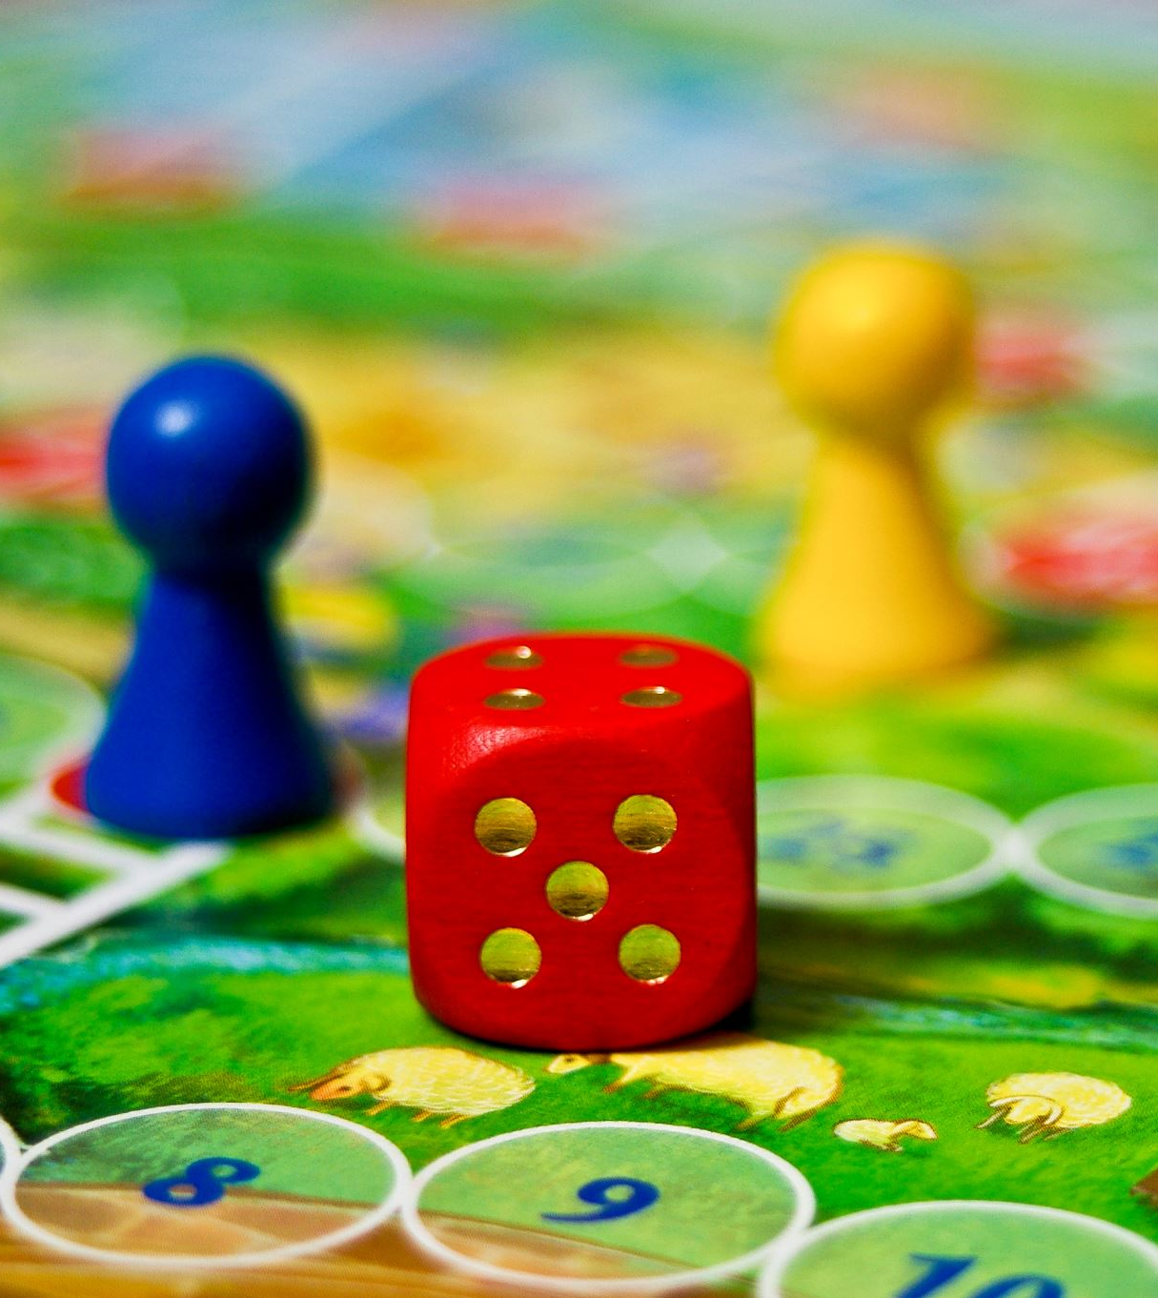
Agenda
Introduction to Blackjack
Game Structure
Designs of the pages
Game Mechanics
Animations

Slide 3
Introduction to Blackjack
Blackjack is a popular card game where players aim to get as close as possible to 21 without exceeding it.
The game is typically played between multiple players and a dealer.
This version replicates a basic Blackjack experience using HTML and CSS.
Focuses on user actions like betting, hitting, and standing, with visual feedback.
Developed to demonstrate interaction and animations in web games.

Slide 4
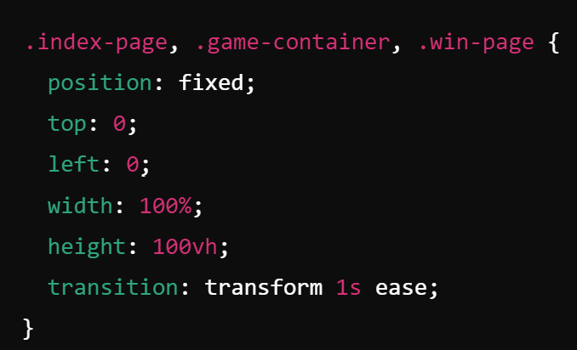
Three Main Pages
The game consists of three main sections:
Index Page: The welcome screen.
Game Page: Where the game itself takes place.
Win Page: A celebratory screen shown after a win.
The transitions between these pages use the following CSS styles:

Slide 5
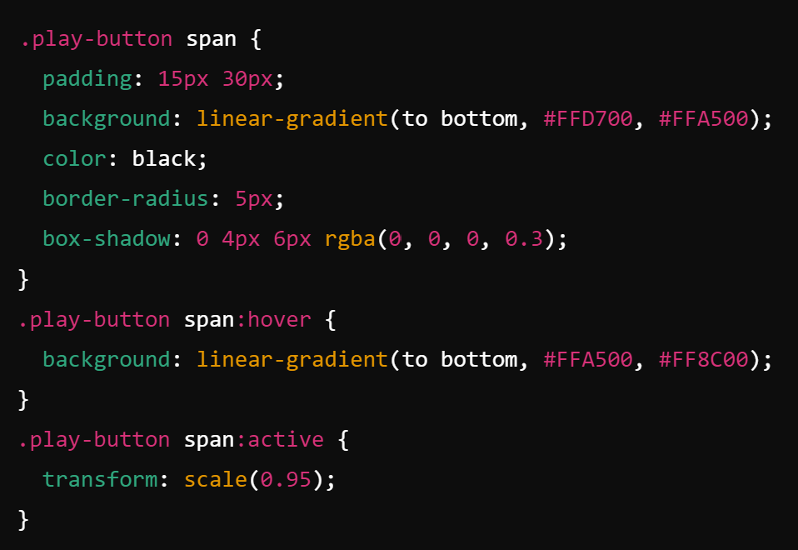
Index Page Design
The Index Page presents the user with a welcome message and a “Play Game” button.
The button has hover and click effects as that give the button a polished and interactive feel.

Slide 6
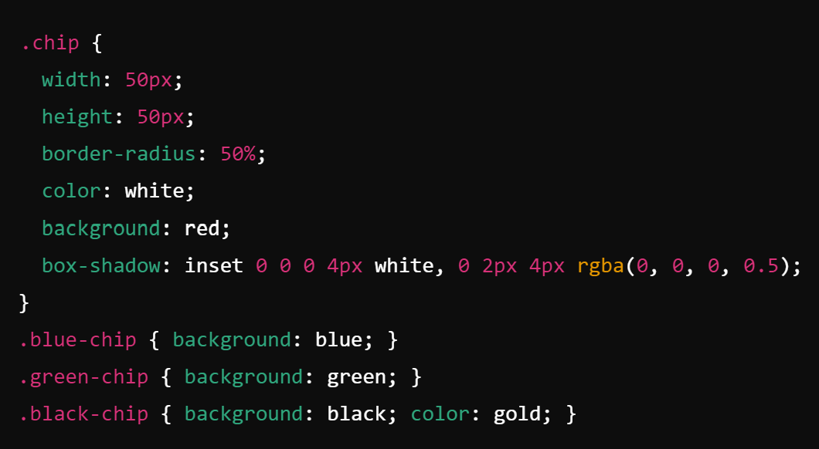
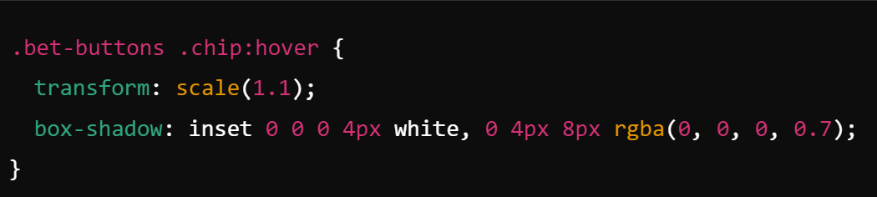
Betting System
Players can place bets using chips of different values
Blue chip: 50 coins
Green chip: 100 coins
Black chip: 200 coins
Hovering over the chips slightly enlarges them and adds a shadow, making them stand out visually:

Slide 7
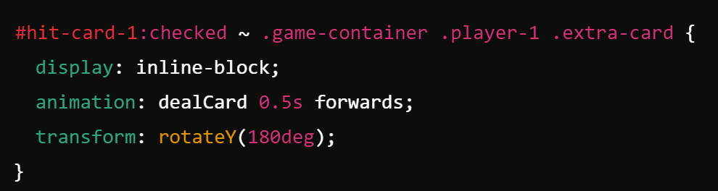
Player Actions : Hit and Stand
Players can choose to "Hit" (draw an additional card) or "Stand" (keep their hand).
The Hit option reveals an extra card using this CSS style.
This reveals the card and rotates it to show the front, giving the effect of a card being dealt

Slide 8
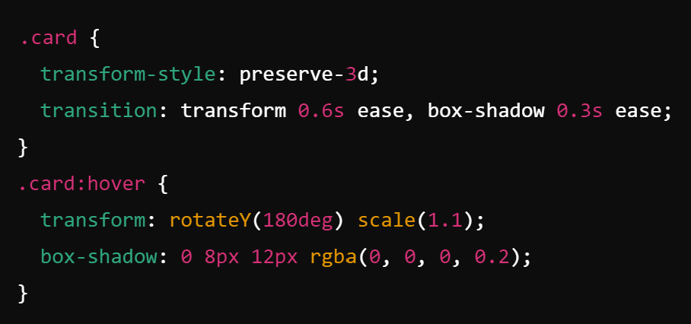
Card Animations
Cards have a flip animation when hovered over, simulating the turning of a card.
This creates the effect of a smooth 3D flip, along with a scaling effect when hovered
This uses the following CSS properties.

Slide 9
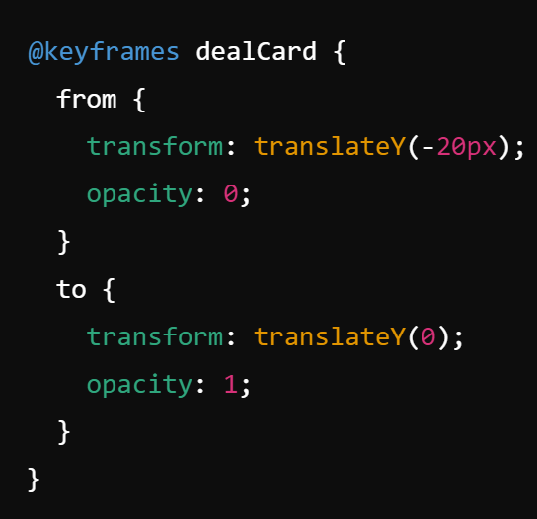
Dealing Animation
The extra card for Player 1 id dealt with the following dealCard animation.
This simulates the card being dealt from above and sliding into place with a fade-in effect.

Slide 10
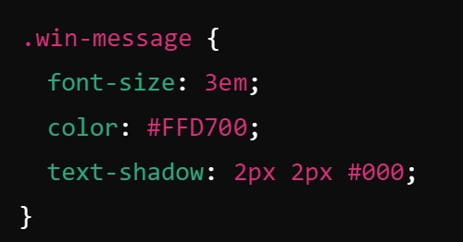
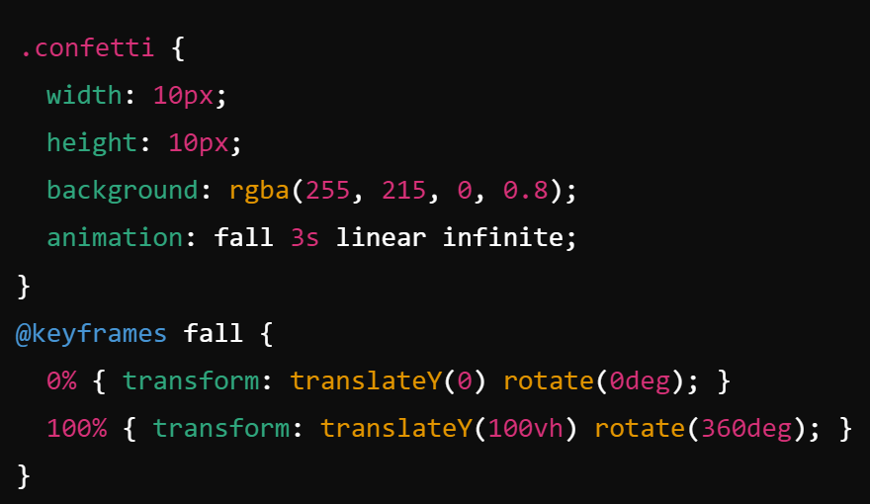
Win Page and Confetti Animation
When a player wins, they are directed to the Win Page, where the message is styled as follows:
The golden text-shadow creates a celebratory feel, making the message more visually impactful.
On the Win Page, a confetti animation is triggered.
Confetti pieces fall from the top of the screen, rotating as they descend.

Slide 11
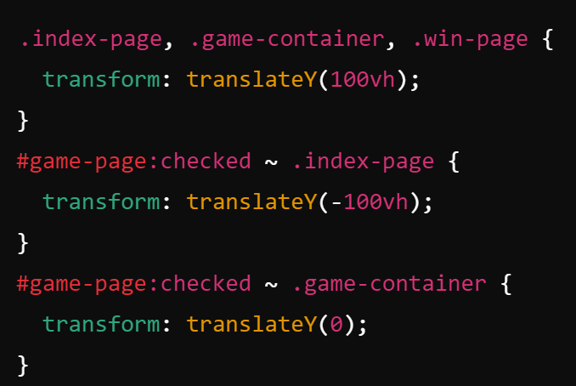
CSS Transitions
The page transitions are handled with CSS transform: translateY for a sliding effect.
These transitions create a smooth flow between the Index, Game, and Win pages

Slide 12
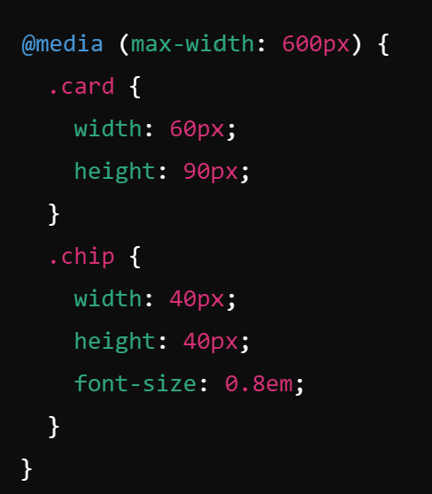
Responsiveness of the Game
The game is responsive and adapts to different screen sizes using media queries.
For smaller screens, the card and chip sizes are reduced to maintain usability.

Slide 13
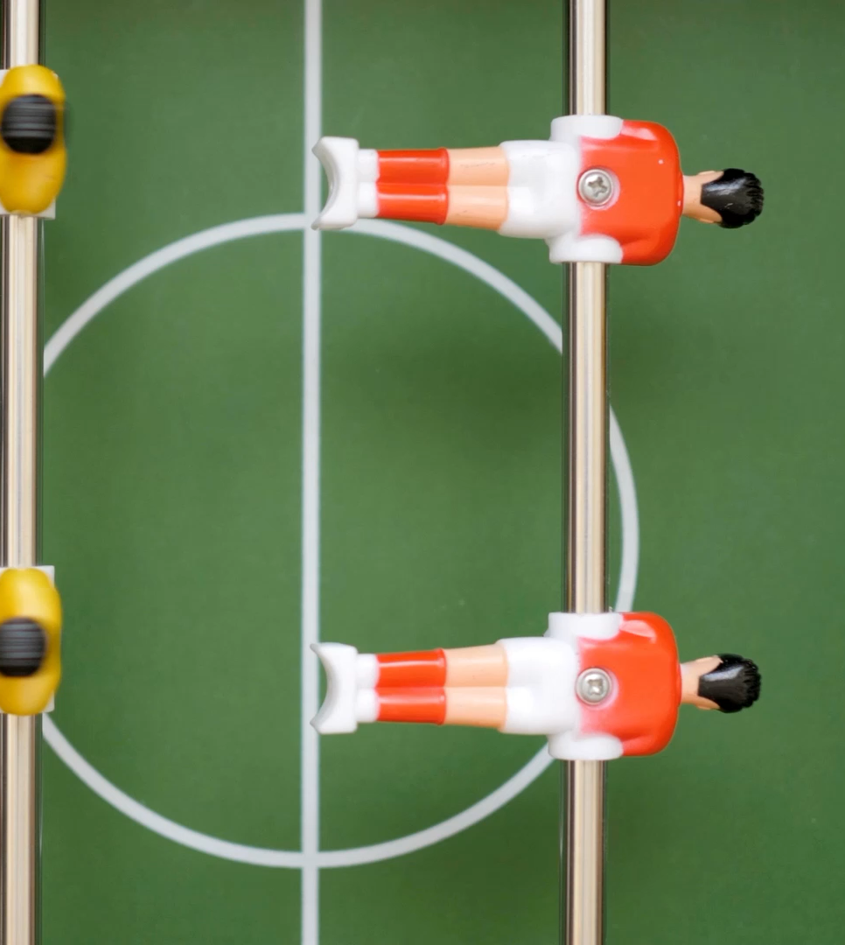
Game Presentation

Slide 14
Thank you

